Slide 1
Software Requirement Specification (SRS)

Slide 2
Definition
Software Requirement Specification (SRS) format as the name suggests, is a complete specification and description of requirements of the software that need to be fulfilled for the successful development of the software system. These requirements can be functional as well as non-functional depending upon the type of requirement. The interaction between different customers and contractors is done because it is necessary to fully understand the needs of customers.

Slide 3
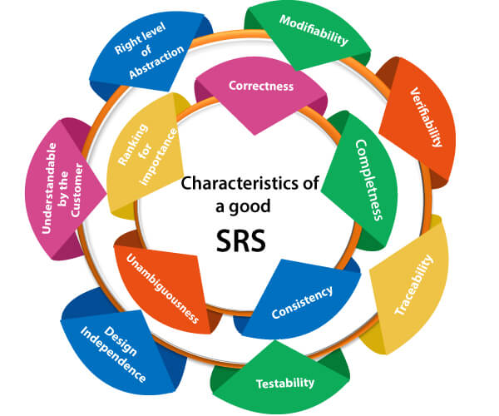
Characteristics of a Good SRS

Slide 4
1. Correctness: User review is used to provide the accuracy of requirements stated in the SRS. SRS is said to be perfect if it covers all the needs that are truly expected from the system.
2. Completeness: The SRS is complete if, and only if, it includes the following elements:
(i). All essential requirements, whether relating to functionality, performance, design, constraints, attributes, or external interfaces.
(ii). Definition of their responses of the software to all realizable classes of input data in all available categories of situations.
Characteristics of a Good SRS
(Contd..)

Slide 5
3. Consistency: The SRS is consistent if, and only if, no subset of individual requirements is described in its conflict. There are three types of possible conflict in the SRS:
(1). The specified characteristics of real-world objects may conflict. For example,
(a) The format of an output report may be described in one requirement as tabular but in another as textual.
(b) One condition may state that all lights shall be green while another states that all lights shall be blue.
(2). There may be a reasonable or temporal conflict between the two specified actions. For example,
(a) One requirement may determine that the program will add two inputs, and another may determine that the program will multiply them.
(b) One condition may state that "A" must always follow "B," while other requires that "A and B" co-occurs.
(3). Two or more requirements may define the same real-world object but use different terms for that object. For example, a program's request for user input may be called a "prompt" in one requirement's and a "cue" in another. The use of standard terminology and descriptions promotes consistency.
Characteristics of a Good SRS
(Contd..)

Slide 6
4. Unambiguousness: SRS is unambiguous when every fixed requirement has only one interpretation. This suggests that each element is uniquely interpreted. If a method is used with multiple definitions, the requirements report should determine the implications in the SRS so that it is clear and simple to understand.
5. Ranking for importance and stability: The SRS is ranked for importance and stability if each requirement in it has an identifier to indicate either the significance or stability of that particular requirement.
6. Modifiability: SRS should be made as modifiable as likely and should be capable of quickly obtain changes to the system to some extent. Modifications should be perfectly indexed and cross-referenced.
7. Verifiability: SRS is correct when the specified requirements can be verified with a cost-effective system to check whether the final software meets those requirements. The requirements are verified with the help of reviews.
8. Traceability: The SRS is traceable if the origin of each requirement is clear and if it facilitates referencing each condition in future development or enhancement documentation.
9. Design Independence: There should be an option to select from multiple design alternatives for the final system. More specifically, the SRS should not contain any implementation details.
Characteristics of a Good SRS
(Contd..)

Slide 7
10. Testability: An SRS should be written in such a method that it is simple to generate test cases and test plans from the report.
11. Understandable by the customer: An end user may be an expert in his/her explicit domain but might not be trained in computer science. Hence, the purpose of formal notations and symbols should be avoided too as much extent as possible. The language should be kept simple and clear.
12. The right level of abstraction: If the SRS is written for the requirements stage, the details should be explained explicitly. Whereas, for a feasibility study, fewer analyses can be used. Hence, the level of abstraction is modified according to the objective of the SRS.
Characteristics of a Good SRS
(Contd..)

Slide 8
COMPONENTS OF An SRS DOCUMENT

Slide 9
Introduction
Purpose of this Document – First, the main aim of why this document is necessary and what the purpose of the document is explained and described.
Scope of this document – In this, the overall working and main objective of the document and what value it will provide to the customer is described and explained. It also includes a description of the development cost and time required.
Overview – In this, the description of the product is explained. It’s simply a summary or overall review of the product.

Slide 10
General Description
In this, the general functions of the product including the objective of the user, a user characteristic, features, benefits, and why its importance is mentioned. It also describes the features of the user community.
Intended audience: Describe your ideal audience. They will dictate the look and feel of your product and how you market it.
Intended use: Imagine how your audience will use your product. List the functions you provide and all the possible ways your audience can use your product depending on their role. It’s also good practice to include use cases to illustrate your vision.
Definitions and acronyms: Every industry or business has its own unique acronyms or jargon. Lay out the definitions of the terms you are using in your SRS to ensure all parties understand what you’re trying to say.

Slide 11
Functional Requirements
Use your overview as a reference to check that your requirements meet the user’s basic needs as you fill in the details. There are thousands of functional requirements to include depending on your product. Some of the most common are:
If/then behaviors
Data handling logic
System workflows
Transaction handling
Administrative functions
Regulatory and compliance needs
Details of operations conducted for every screen.

Slide 12
Performance Requirements
In this, how a software system performs desired functions under specific condition is explained. It also explains required time, required memory, maximum error rate, etc. The performance requirements part of an SRS specifies the performance constraints on the software system. All the requirements relating to the performance characteristics of the system must be specified. There are two types of performance requirements: static and dynamic. Static requirements are those that do not impose constraints on the execution characteristics of the system. Dynamic requirements specify constraints on the execution behavior of the system.

Slide 13
External interface requirements
External interface requirements are types of functional requirements that ensure the system will communicate properly with external components, such as:
User interfaces: The key to application usability that includes content presentation, application navigation, and user assistance, among other components.
Hardware interfaces: The characteristics of each interface between the software and hardware components of the system, such as supported device types and communication protocols.
Software interfaces: The connections between your product and other software components, including databases, libraries, and operating systems.
Communication interfaces: The requirements for the communication functions your product will use, like emails or embedded forms.

Slide 14
Non-Functional Attributes
The most common types of NFRs are called the ‘Itys’. They are:
Security: What’s needed to ensure any sensitive information your software collects from users is protected.
Capacity: Your product’s current and future storage needs, including a plan for how your system will scale up for increasing volume demands.
Compatibility: The minimum hardware requirements for your software, such as support for operating systems and their versions.
Reliability and availability: How often you expect users to be using your software and what the critical failure time is under normal usage.
Scalability: The highest workloads under which your system will still perform as expected.
Maintainability: How your application should use continuous integration so you can quickly deploy features and bug fixes.
Usability: How easy it is to use the product.

Slide 15
Difference between Functional and Non-Functional Requirements
S.No. | Functional Requirements | Non-Functional Requirements
1 | A functional requirement represents software and its elements and features. | It represents the quality characteristic of a system.
2 | The functional requirements mentioned the activities a software system should perform. | It sets some rules and regulations for a software system on how it should fulfil the essential need.
3 | These requirements are established by the user. | These requirements are established by technical persons, such as e.g. software developers, architects, and more.
4 | These requirements are compulsory. | These are not compulsory.
5 | These are easy to define. | These are hard to define.
6 | Functional requirements allow you to measure the functionality of the software. | It allows you to check the performance of the system.
7 | System, Integration, End to End, API testing, etc are functional testing. | Performance, Stress, Usability, Security testing, etc are non-functional testing.
8 | These requirements are vital to system operation. | These are not always vital requirements.

Slide 16

Preliminary Schedule and Budget
In this, initial version and budget of project plan are explained which include overall time duration required and overall cost required for development of project.

Slide 17

Appendices
In this, additional information like references from where information is gathered, definitions of some specific terms, acronyms, abbreviations, etc. are given and explained.

Slide 18
Uses of SRS Document
The development team is required to develop products according to need.
Test plans are generated by the testing group based on the described external behavior.
Maintenance and support staff must understand what the software product should do.
Project manager base their plans and estimates of schedule, effort, and resources on it.
Customers rely on it to know what product they can expect.
As a contract between developer and customer for documentation purposes.

Slide 19

Uses of SRS Document
The development team is required to develop products according to need.
Test plans are generated by the testing group based on the described external behavior.
Maintenance and support staff must understand what the software product should do.
Project manager base their plans and estimates of schedule, effort, and resources on it.
Customers rely on it to know what product they can expect.
As a contract between developer and customer for documentation purposes.

Slide 20
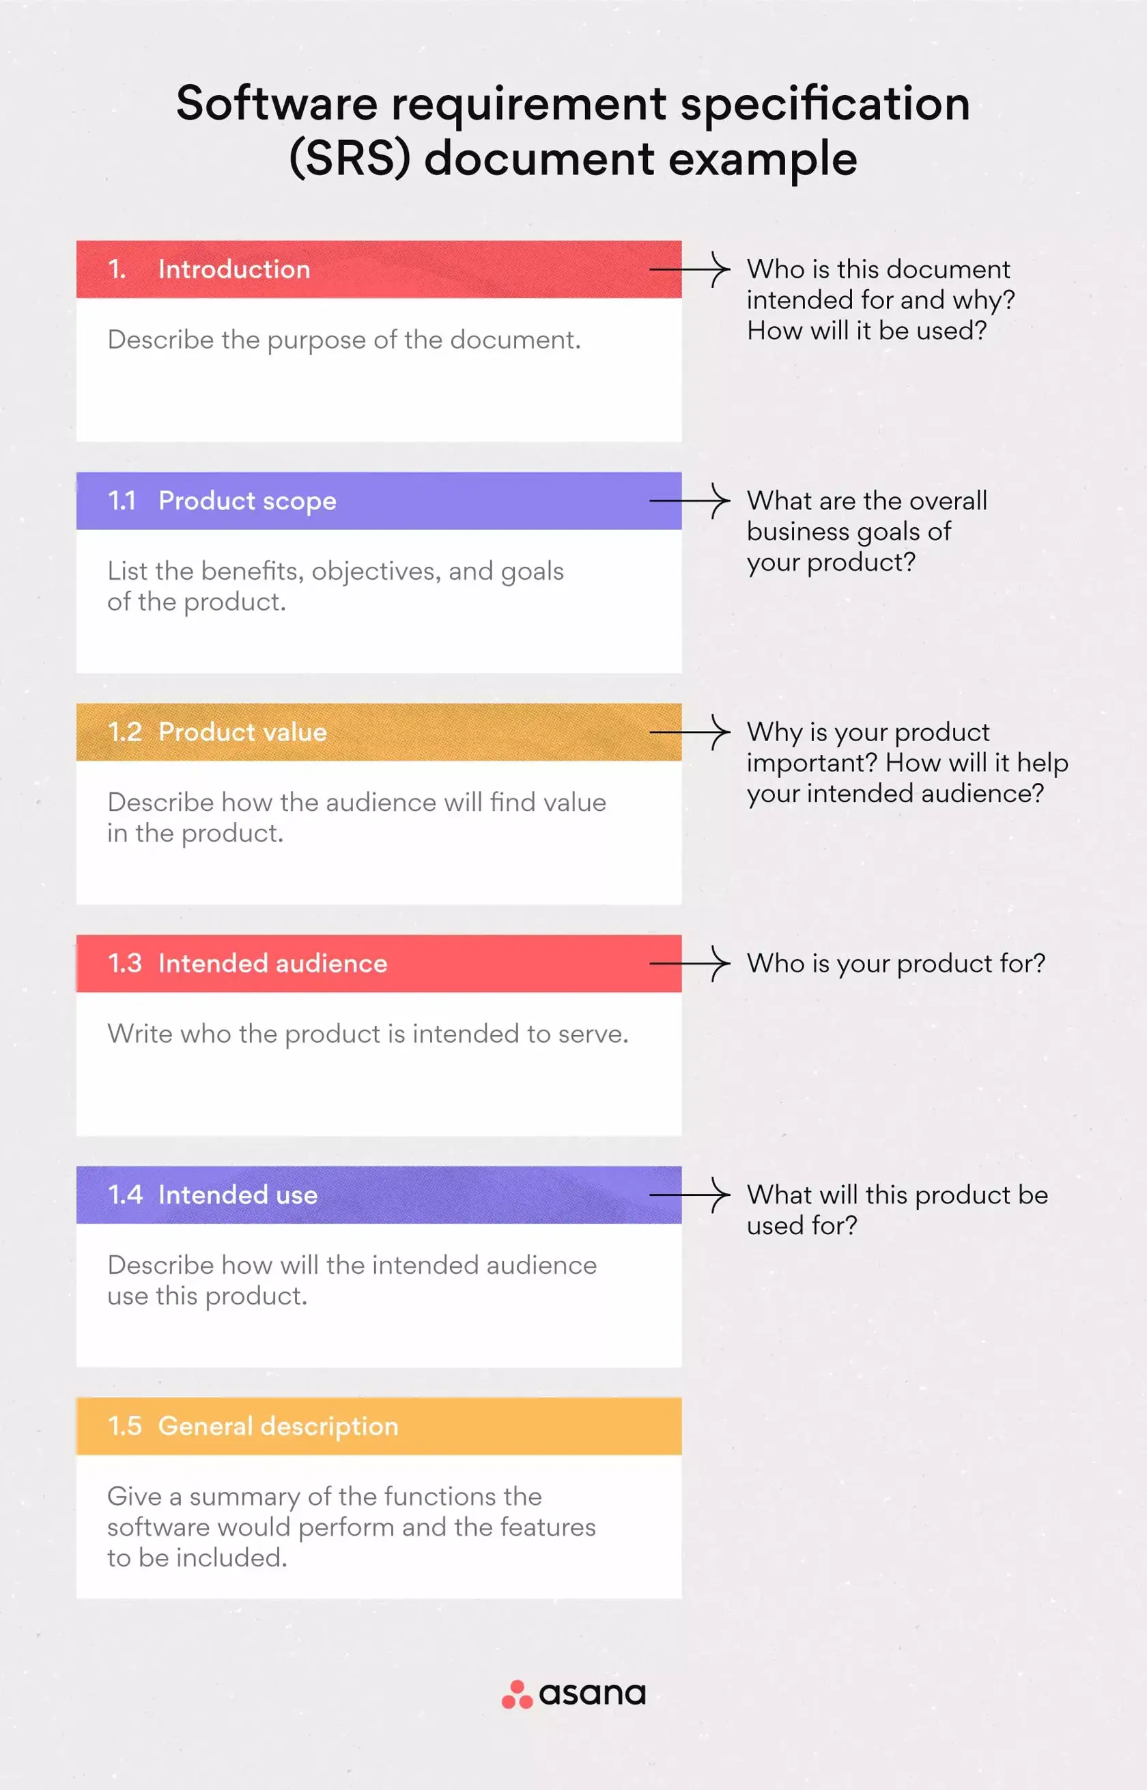

Slide 21
THANK YOU

